Slide 1

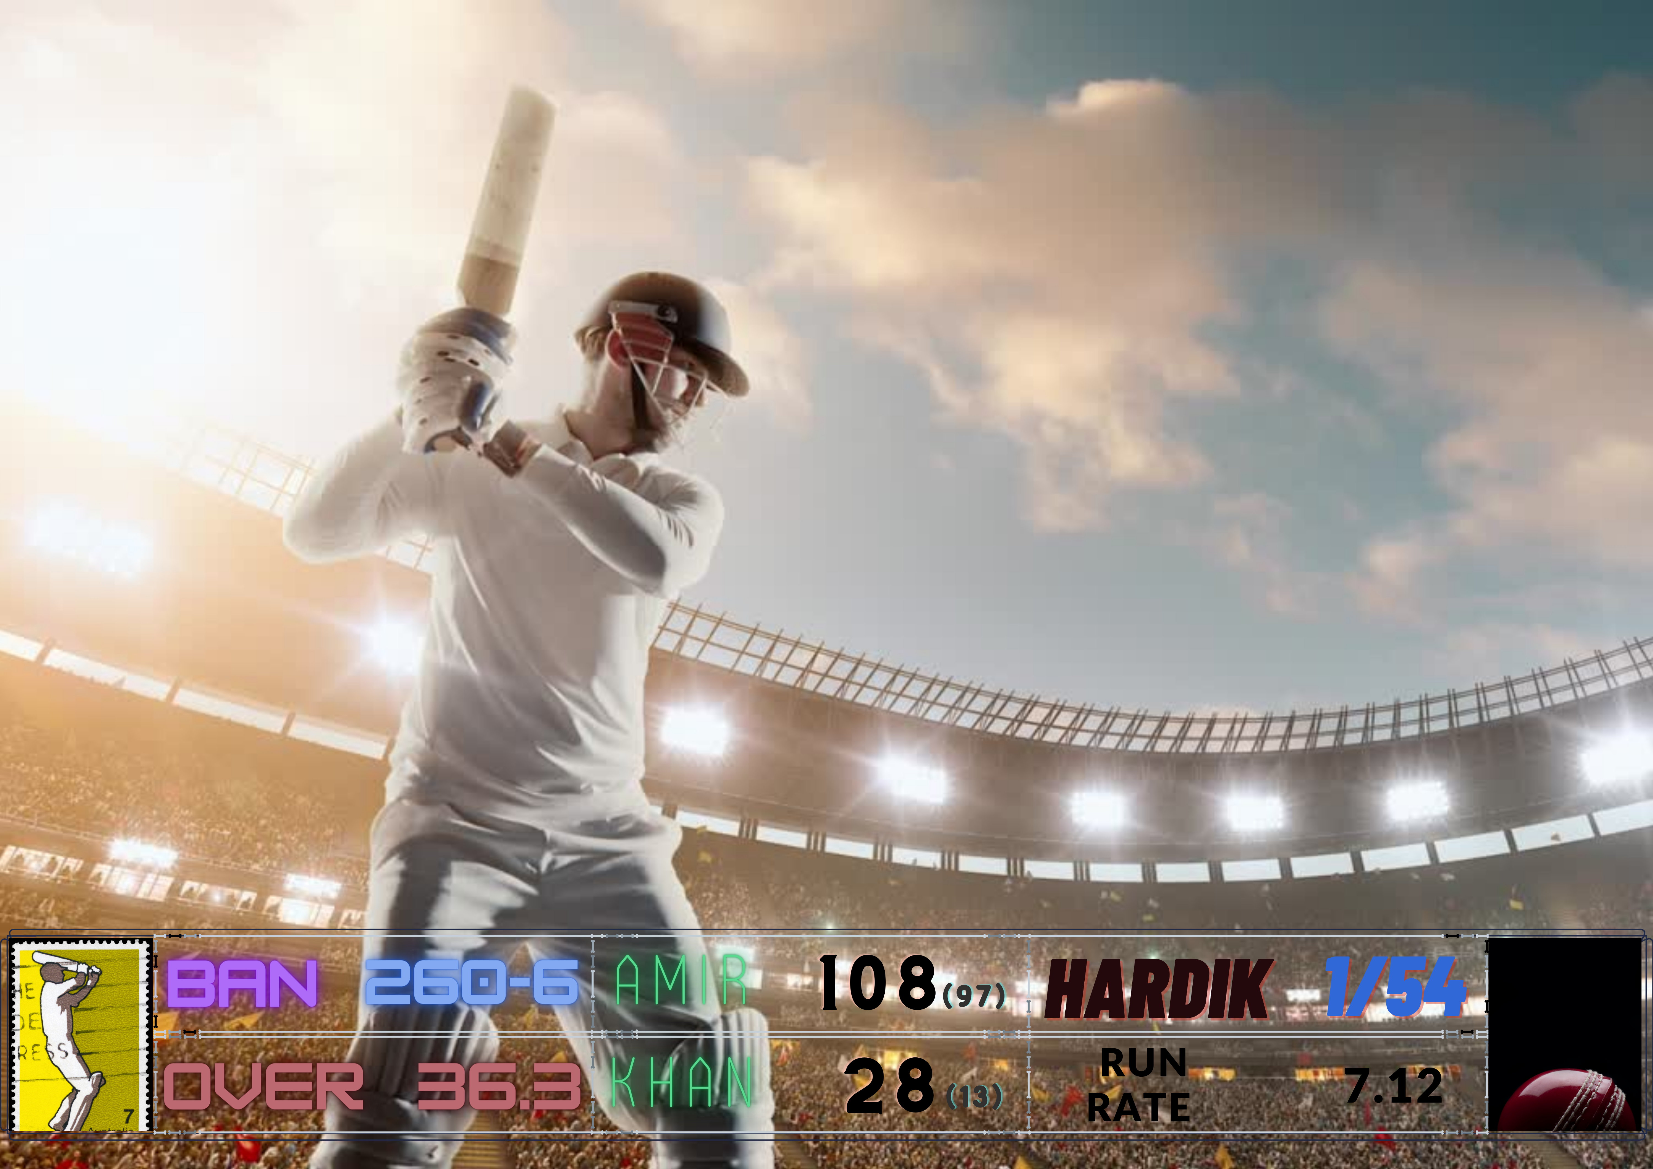
Live Scores
To the team of 11
Time：2022.07.25
START

Slide 2

01.
MD Shakil Anower Samrat
Team Members
Roll 307
02.
MD Jannatul Nayem
Roll 338
03.
MD Sujon Ahamed
Roll 328
04.
MD Shahab Uddin
Roll 318
05.
Tajnim Jaman Mim
Roll 366

Slide 3
Project Flow Chart
Requirement analysis
Tool selection
Interference design
Implement the design
Add events and handler methods
Database Integration
Co ordination
Optimization

Slide 4
Methodology
Completing home page requirement to start the game.
Arrange New Match
New Team
Go to match
Update Match
Create each team to start scoreboard
Name of team
Select Captain
Select Other Players
Set Innings to determine a team action.
Toss Result
Batting
Defending
Over
Update scoreboard
Update Run by Ball
Update Extra Run
Update Wicket
Which Cricketer is Batting & Bowling

Slide 5
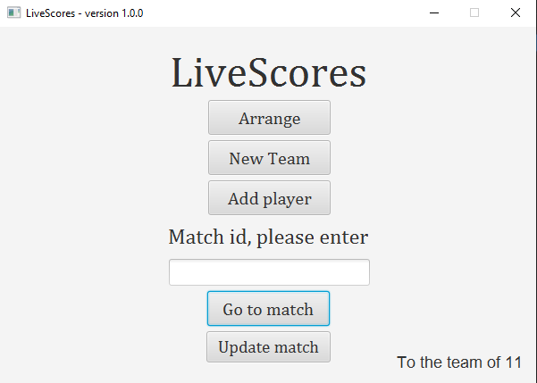
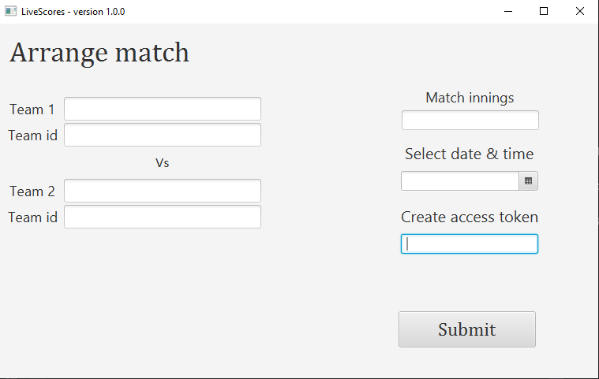
Project Output

Slide 6
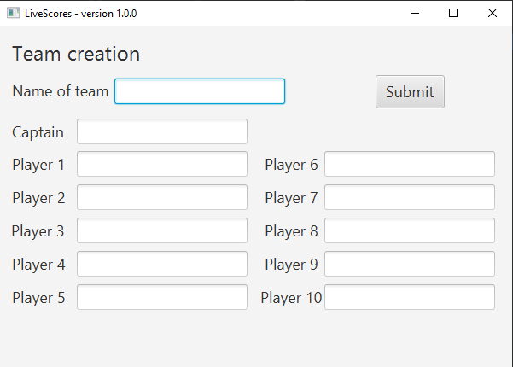
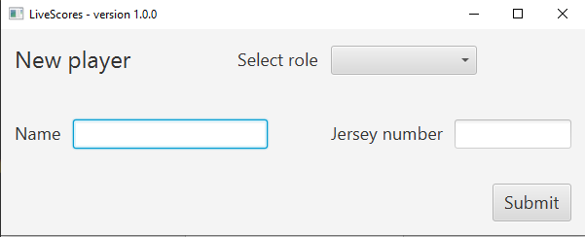
Project Output

Slide 7
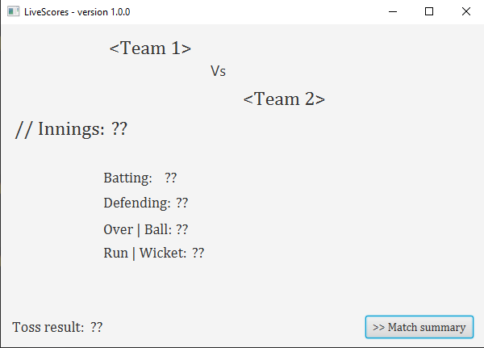
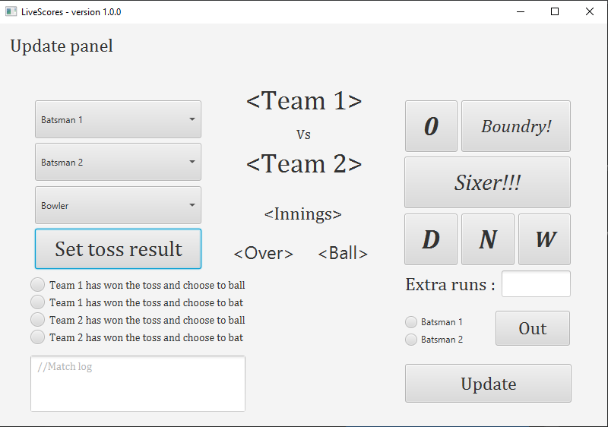
Project Output

Slide 8

Limitation
Multiple users cannot access this software server because API is not used. We have not provided the API for our system due to time limitations.
The user interface at current stage is barely user friendly that needs a lot of enhancement.
Our database resides on local machines as no cloud services used leading to lack of
Reliability and severe chances of data loss.

Slide 9
Future Scope
This is a corporate project as well.
Softsasi LLC will publish this software once it has met corporate software standards and will provide a freemium bundle.
As a result, it may also be financially beneficial to us.
Standard computerized cricket score system for small tournament organizer.

Slide 10
Conclusion
LiveScores offers free computer scoring software capable of recording and analyzing local, regional, domestic, and recreational cricket matches.
01
As a result of this initiative, small and large tournament organizers will be able to employ a standard computerized cricket score system as a result.
02
This simple, straightforward, and powerful program, which complements the app-based LiveScorers, is totally configurable, making it the ideal solution for the committed scorer.
03

Slide 11

Thanks
for staying with us.

